Slide 1
Cornursery (logo pending)
A Computer Science Capstone Project by Rhys Cabot

Slide 2
What is Cornursery?
Play on Corner and Nursery
Like, the plant kind
A little plant growing simulator that sits in the bottom right of your computer!
Intended to be a controlled distraction
Appears on top of other windows
Sell finished plants for new seeds and other upgrades
Should aim to keep people at their computer with small distractions
Right down here!

Slide 3
I’m not the first to do this!
But I’ll be the first to do it well
The other examples aren’t bad, but they have issues
Cornerpond: Relaxed vibe, easy activity, but it’s way too easy to make progress while away from the computer
This makes idling a dominant strategy
Bongo Cat: Far too idle, 30 minutes between interactions, otherwise does nothing. It’s basically a keyboard pedometer
Desktop Defender: Far too interactive for its own good, way too distracting to make progress

Slide 4
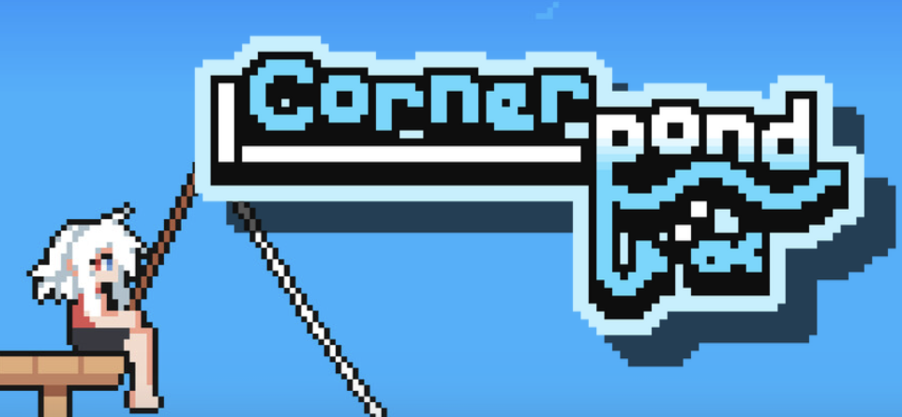
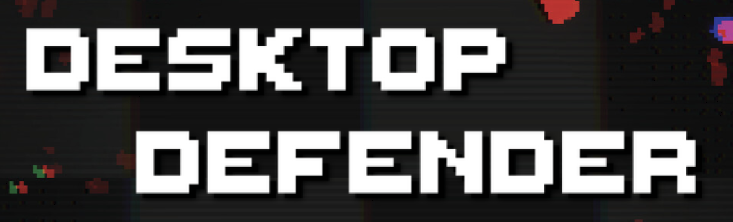

Most other games
Too Idle
Too Distracting
Games that are Too Idle don’t encourage you to stay at your computer
Games that are Too Distracting may draw too much of your focus away from your task
We want to be here

Slide 5
So what will I actually be doing?
Working in Unity 2D (or Godot if I change my mind) to develop a small nursery sim that sits on top of other windows in the corner while you do other things!
I’ll be using pixel art, I’ve used Piskel before but I may look for local software instead of fully online stuff.
User requirements: On top of other windows even when out of focus, only takes up a fraction of the screen
Non-functional requirements: Be fun, don’t be too distracting
Personal wants: Progression systems, many plants, plant record book?

Slide 6
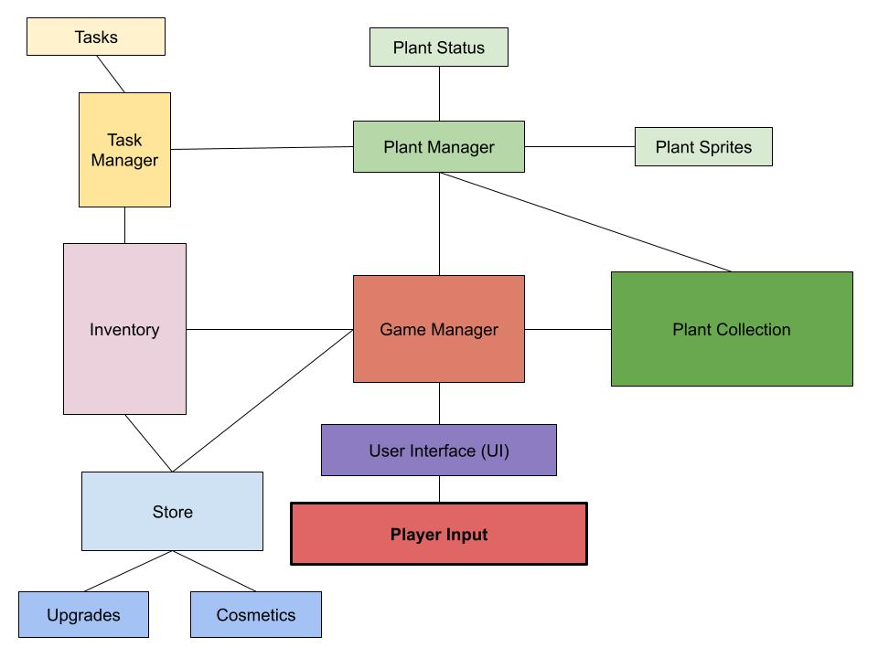

Slide 7
Testing
Ideally, by the day of the partial demo I will have a working demo of the game ready for other students (like you) to test!
I’ll create a form for feedback and pester everyone who gets a demo to please use the game and give me feedback.
Experiment on your younger siblings, it’s great
Internal playtesting with a faster dev build to test certain features
I don’t see how a project like this would cause many game-breaking bugs, but Unity will always surprise you.

Slide 8
Timeline
Prototype Day: The game window always stays on top of other windows and remains active and visible when out of focus
Partial Demo: The plant growing mechanics are working, release this demo to other students to test while they are doing work. May use placeholder sprites.
Full Demo: Progression, visual tune-ups, fine tuned mechanics, an overall more complete build of the game.
These are the hard deadlines; there are smaller soft deadlines to aim for, such as having a prototype UI done by Prototype Day, or having finished sprites for the partial demo.

